Slide 1
Quarterdeck Medical Information
Instructor Florence Holmes

Slide 2

quarterdeck.seacadets.org/secure/Login.aspx

Slide 3
This information needs to completed:
Upon Enrollment
Annually in September
Annually in February
Within 3 months of attending a training

Slide 4
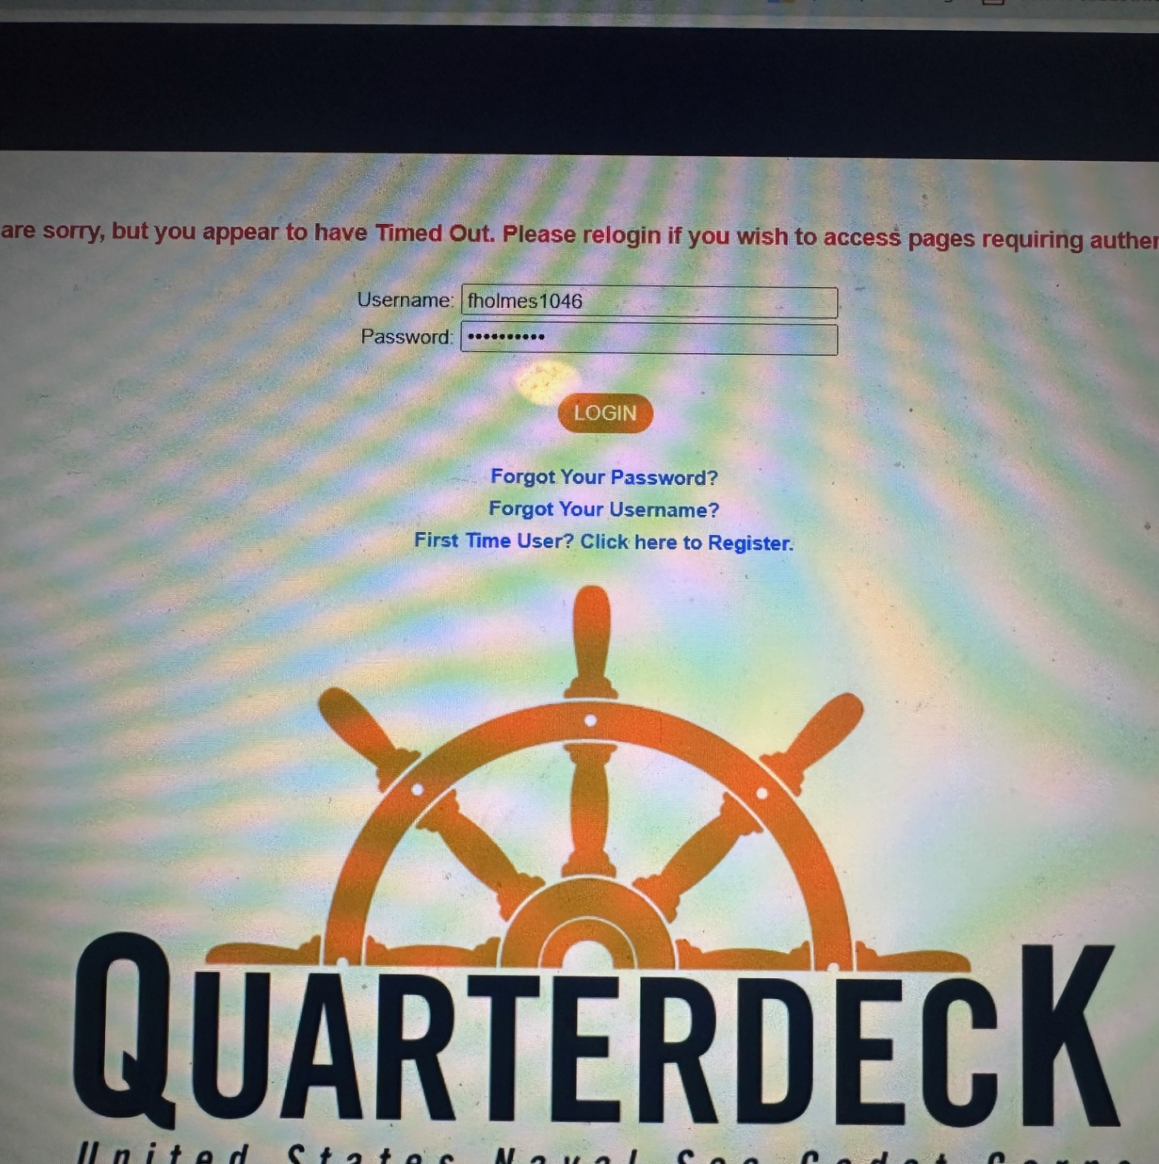
Once in Quarterdeck, log in to your parent account.
Both the parent & child have their own account.

Slide 5
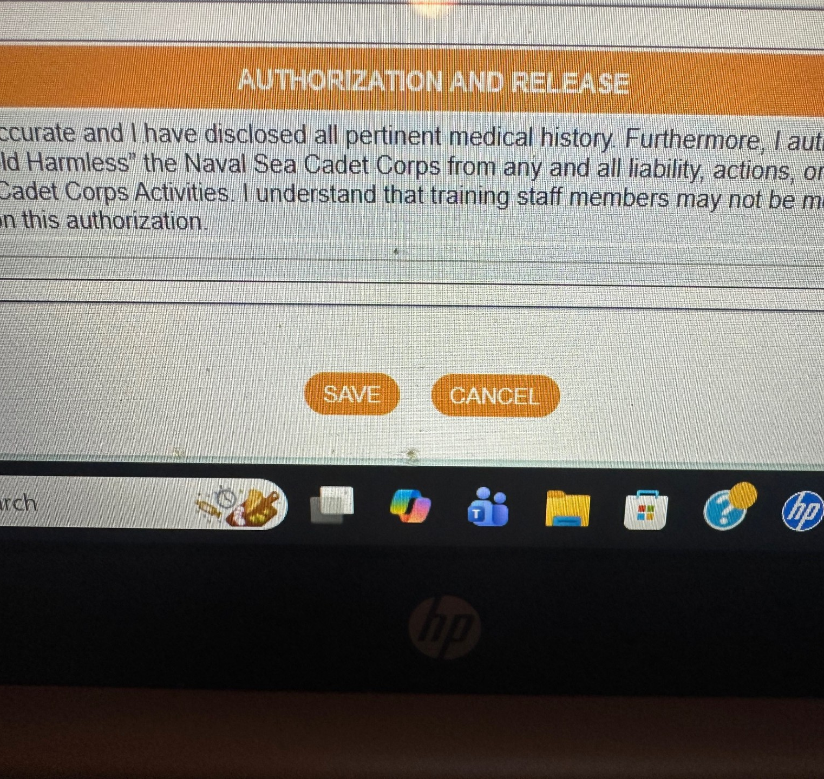
Remember to SAVE the information under each section for the information to be complete

Slide 6
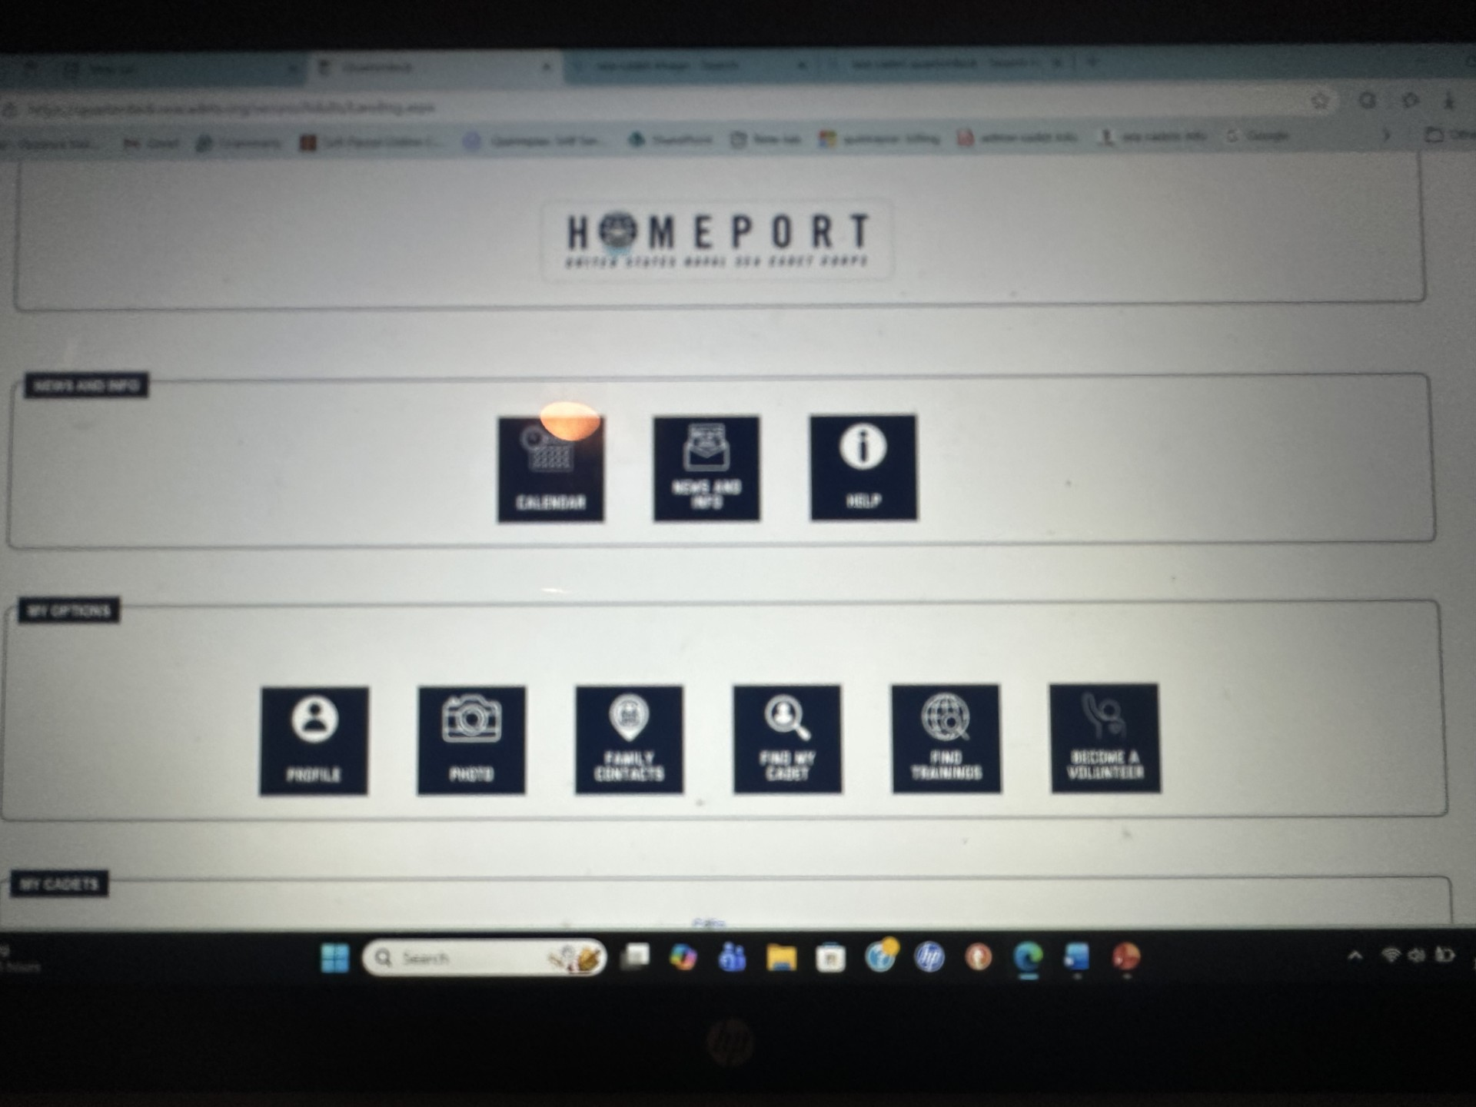
Start from left to right and complete the profile and family contact sections.

Slide 7
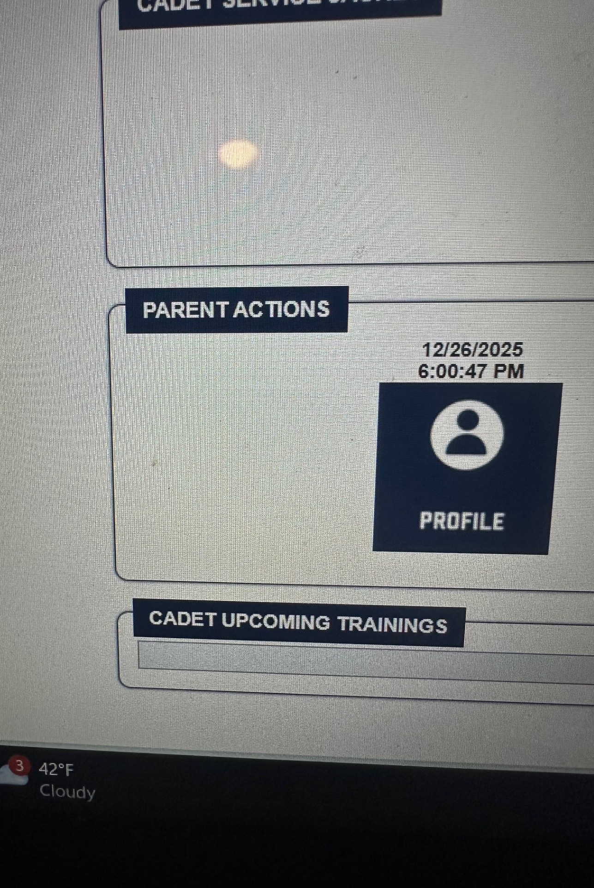
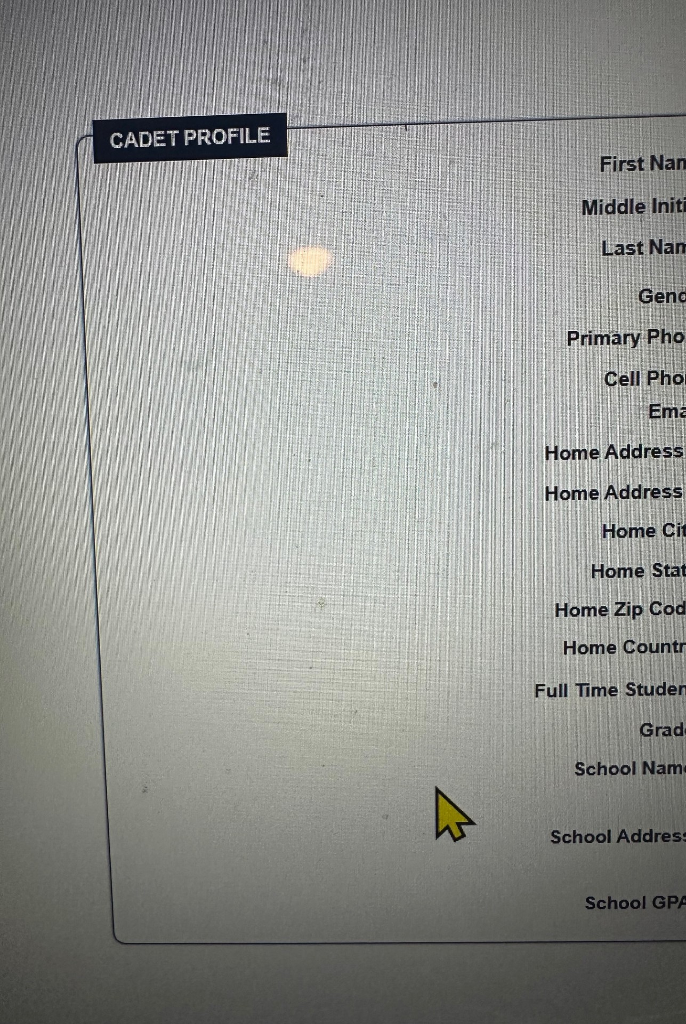
Complete the profile in full

Slide 8
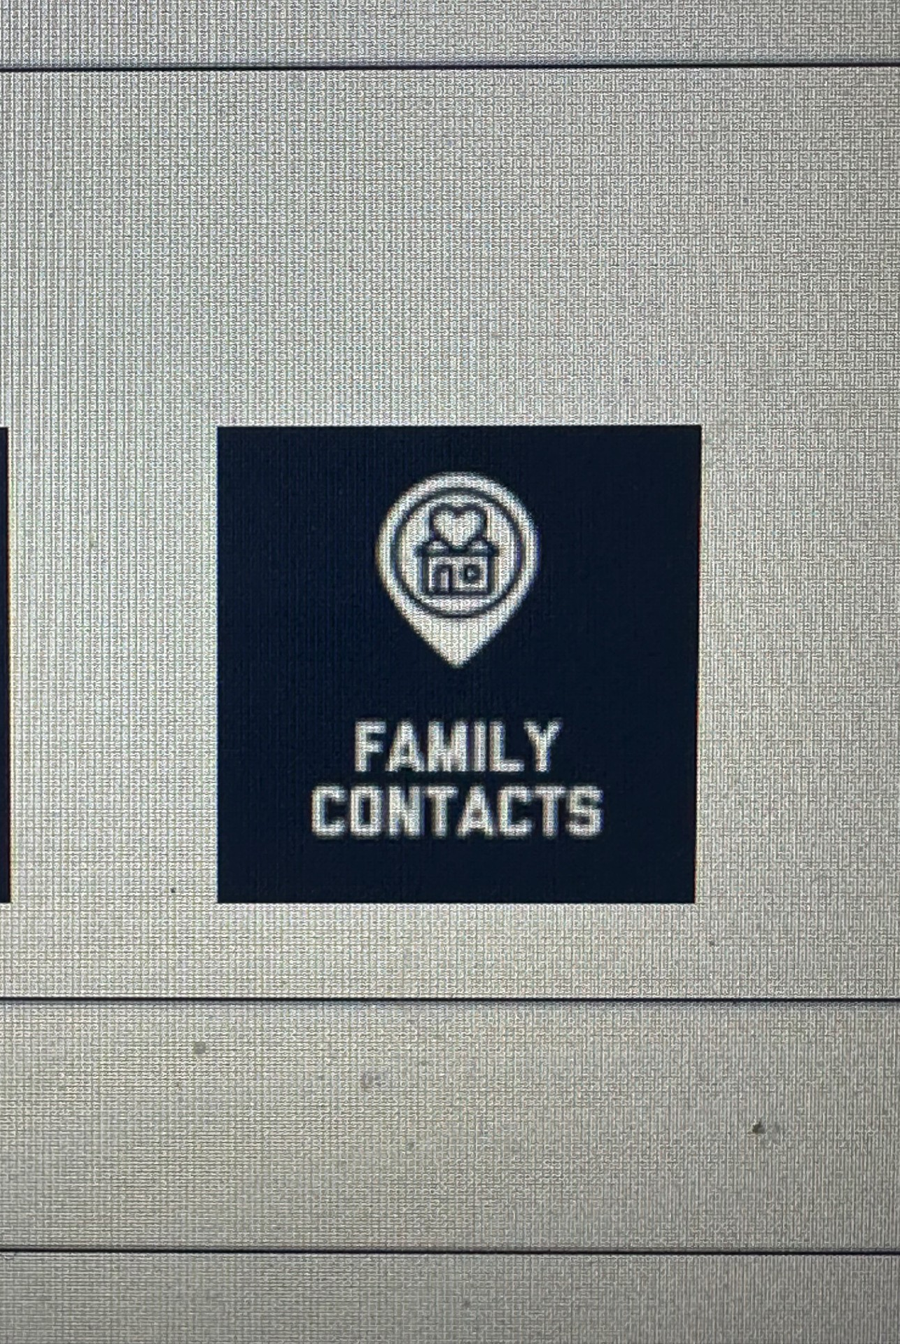
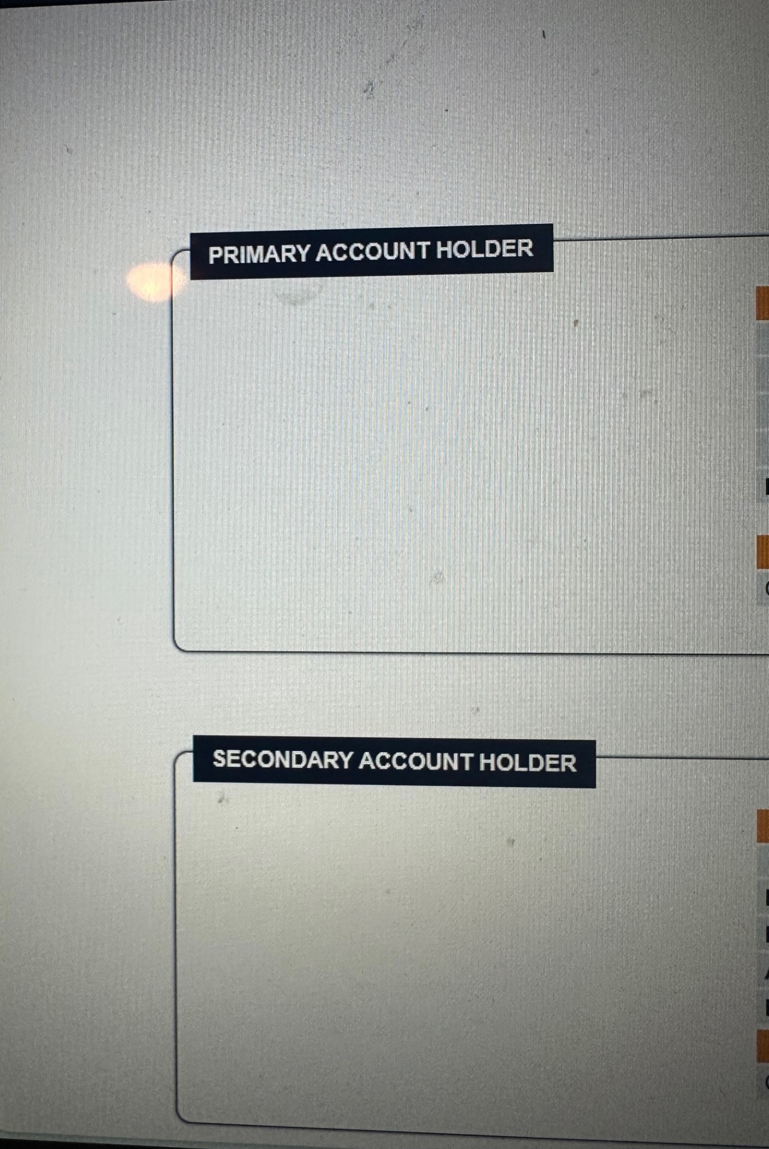
Complete family contacts

Slide 9
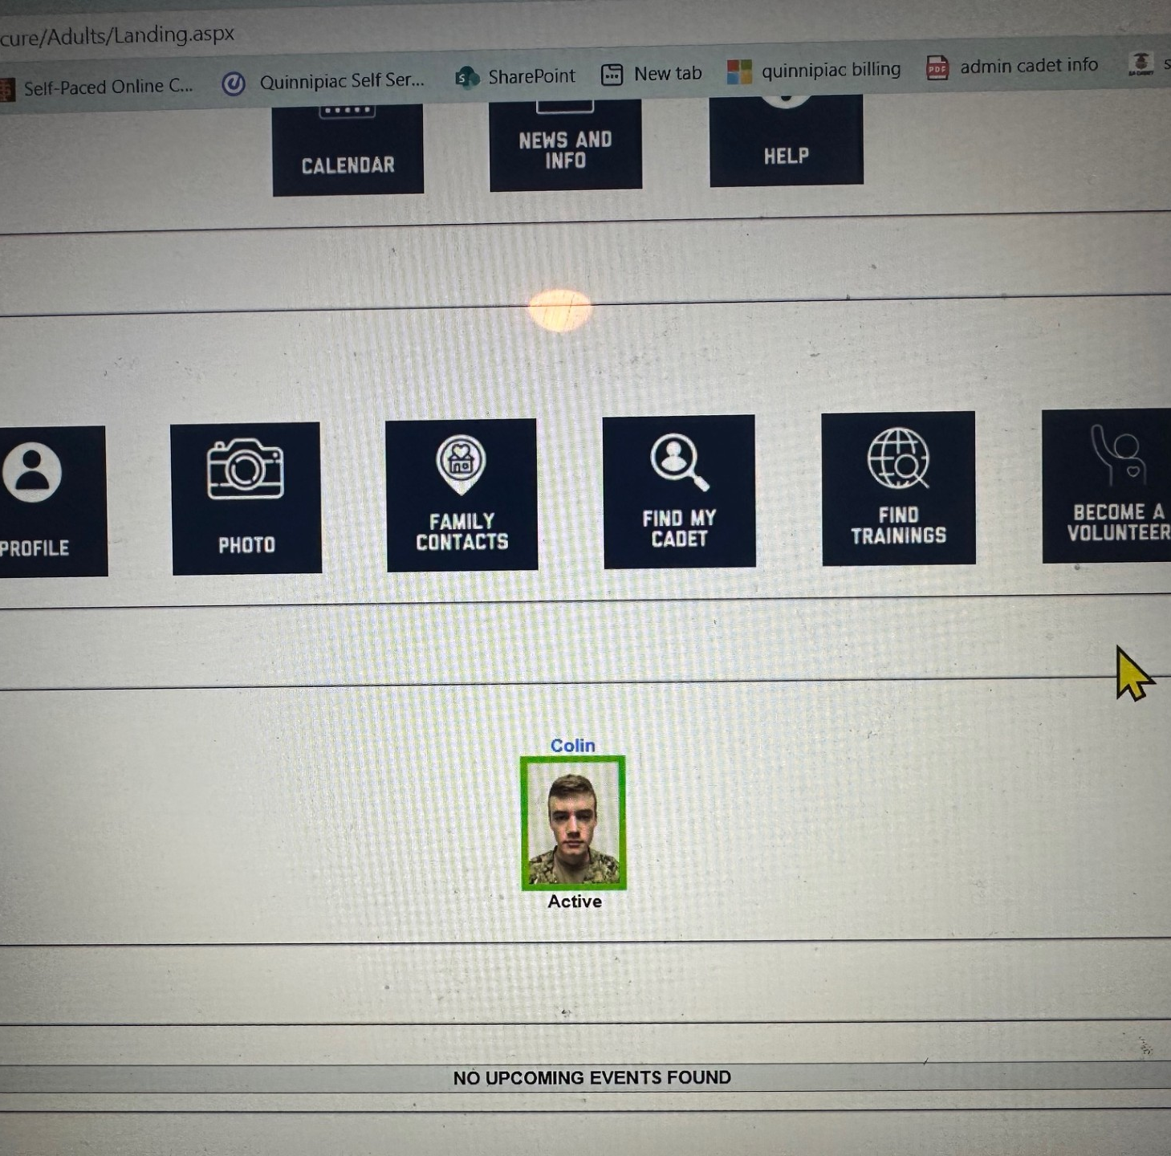
Click on your cadet’s photo image to complete the remaining information

Slide 10
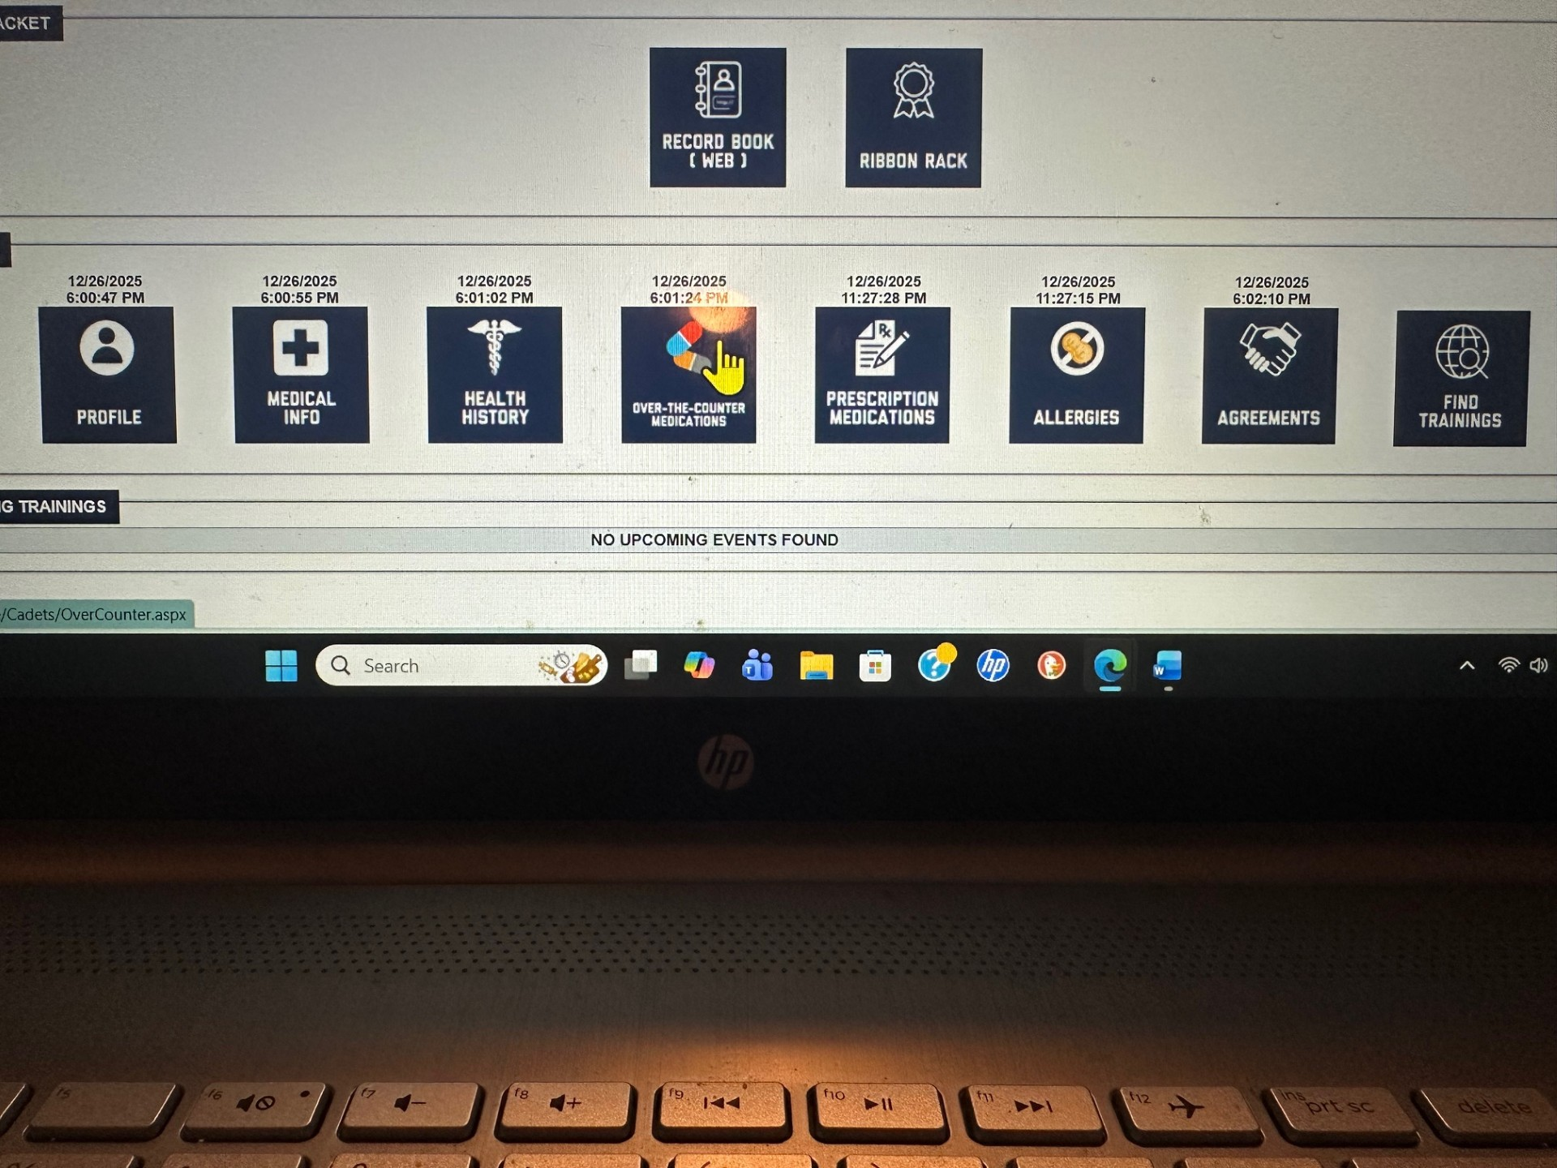
Complete EVERY section left to right from Profile to agreements.

Slide 11
Complete your Cadet’s profile and save

Slide 12
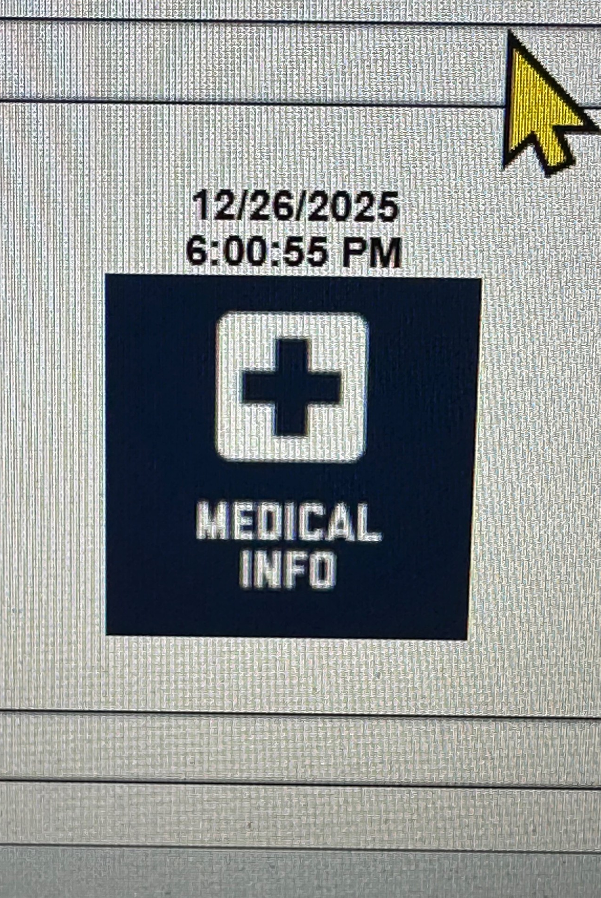
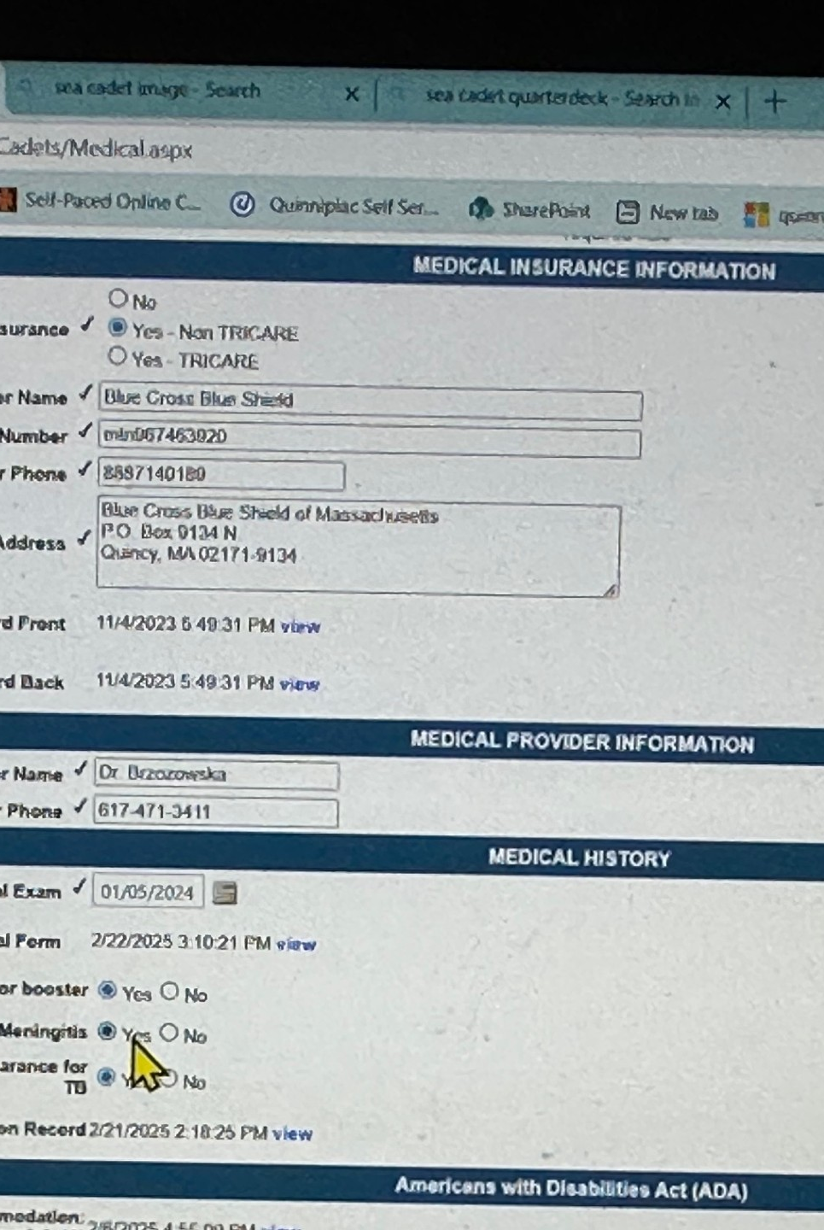
Complete all medical requested medical information.

Slide 13
There is a difference between the physical and immunization form section.
Do not place your annual physical in both sections.
5/6 is the Physical form
Your pediatricians dorm is the immunization form

Slide 14
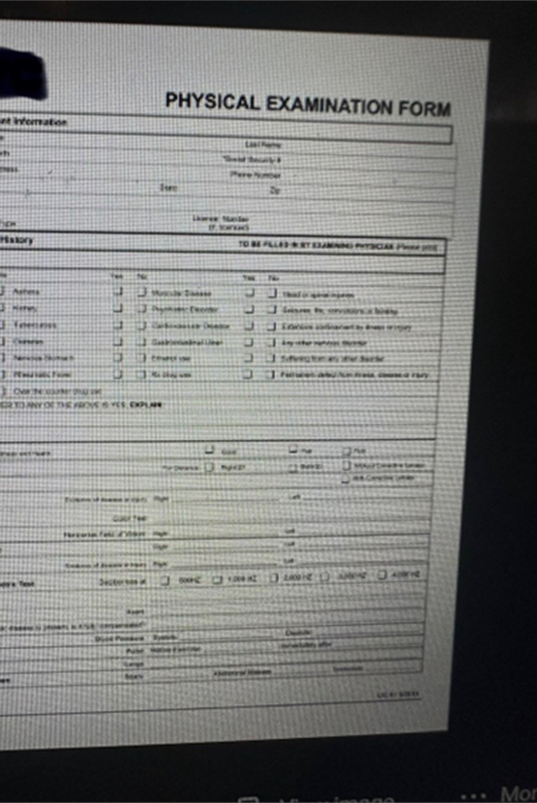
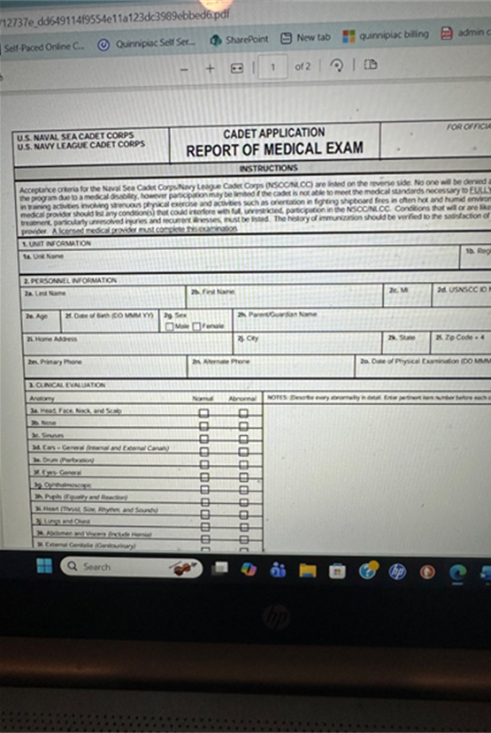
The 5/6 (left) must have a doctor’s signature. Do not upload your other physical form under the physical section. https://www.lmmdseacadets.com/_files/ugd/12737e_dd649114f9554e11a123dc3989ebbed6.pdf
Every doctor’s form (Right) is different. The form must have immunizations and be updated annually in the immunization record section.

Slide 15
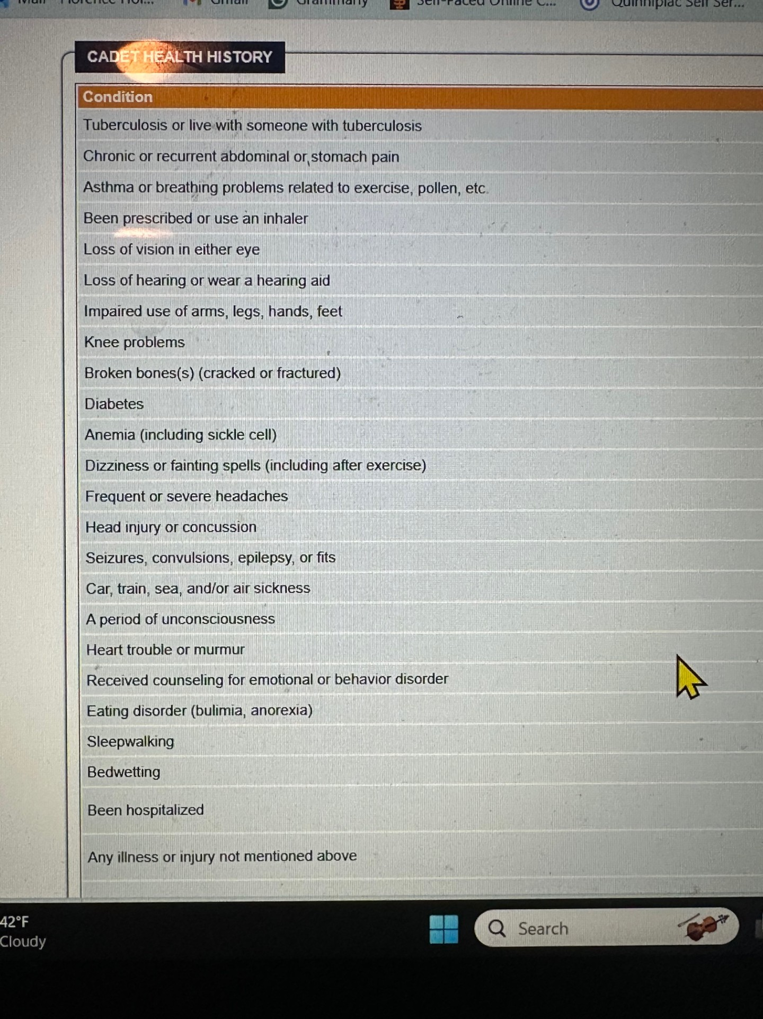

Complete your cadet’s health history in full and save

Slide 16
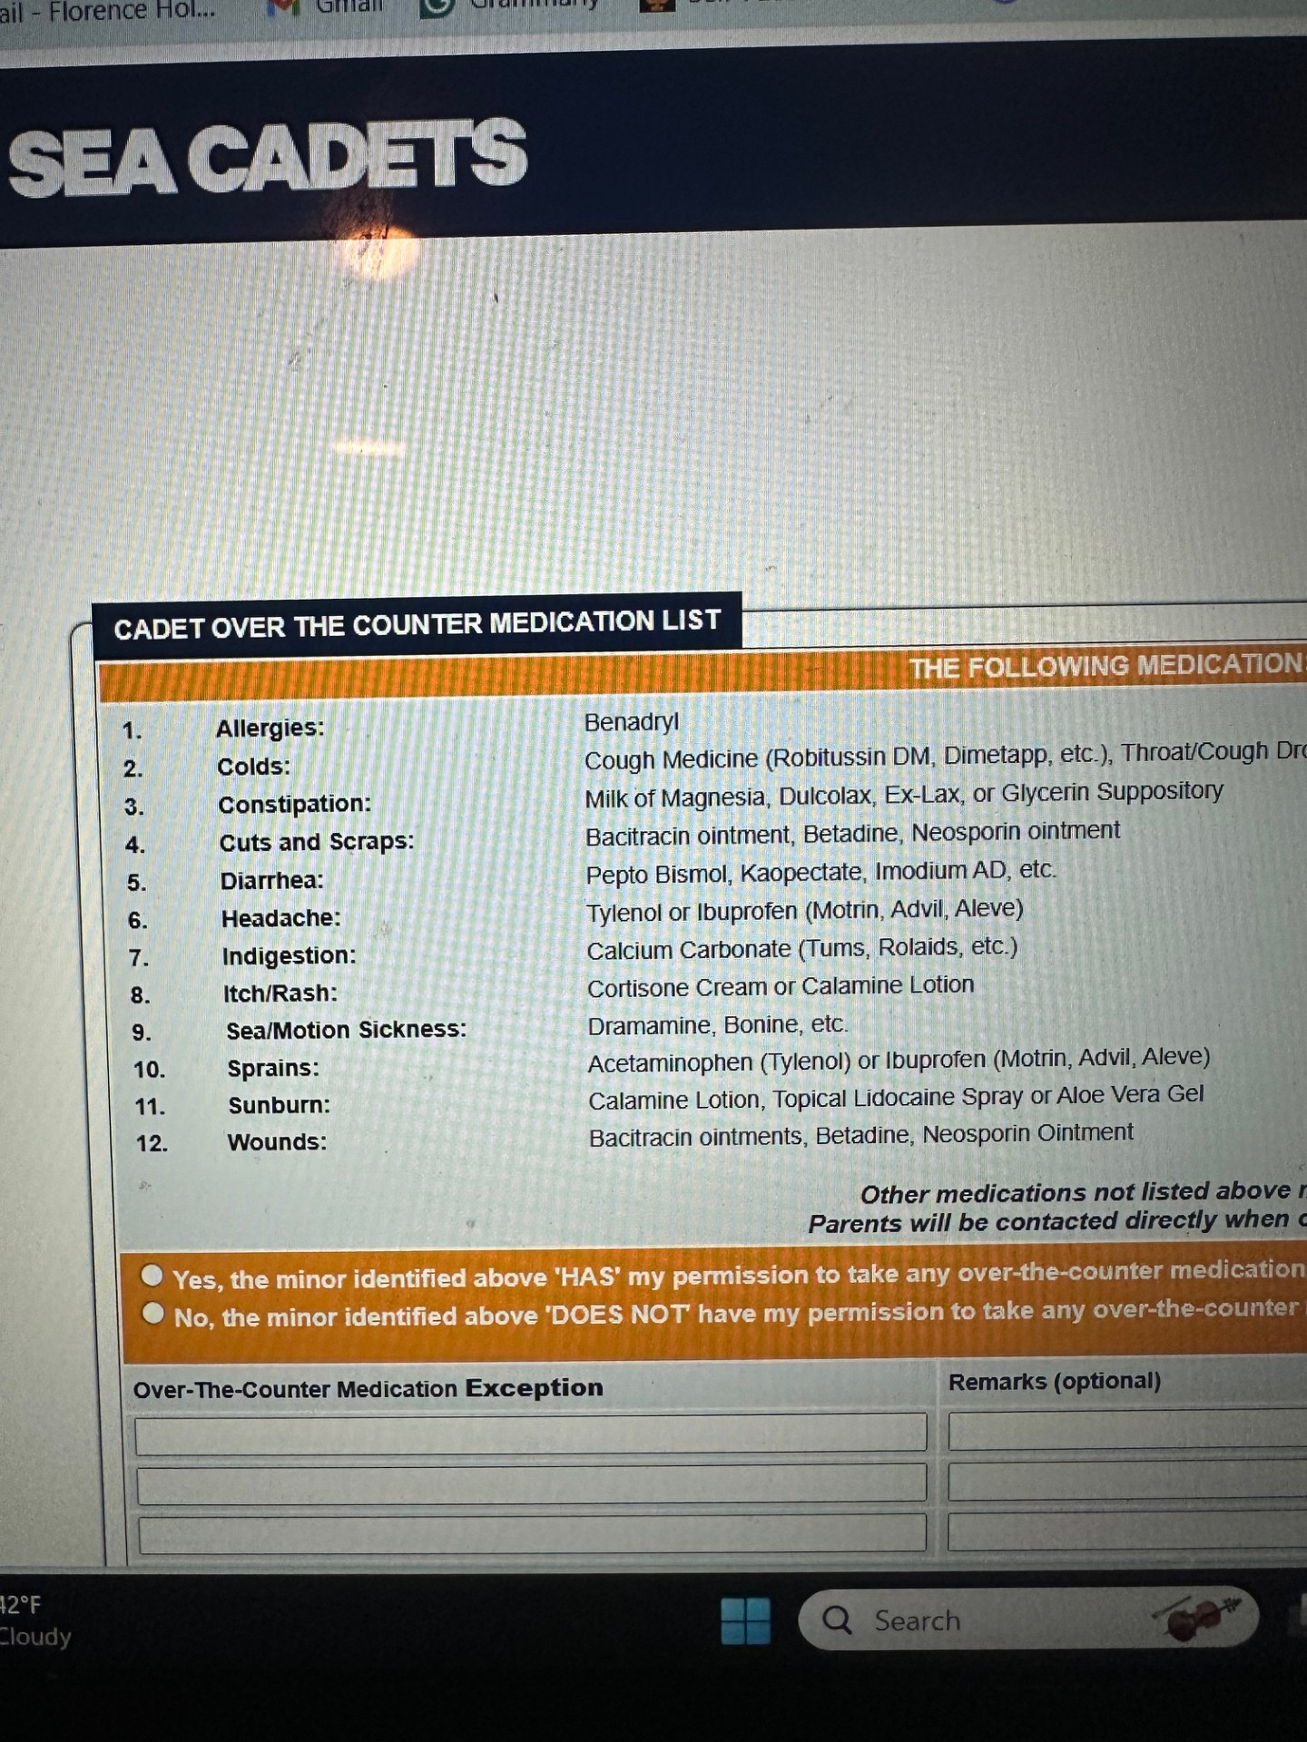
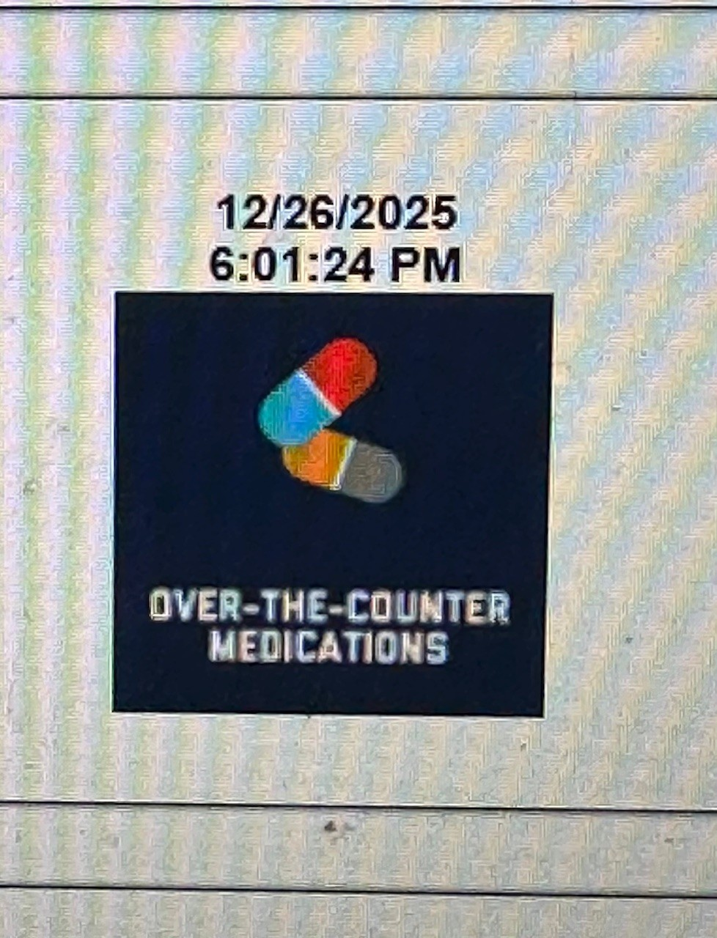
Complete the
Over –The –Counter medication forms and save. We do not have medications other than Tylenol, Motrin & Benadryl on site. However, this is necessary for trainings.

Slide 17
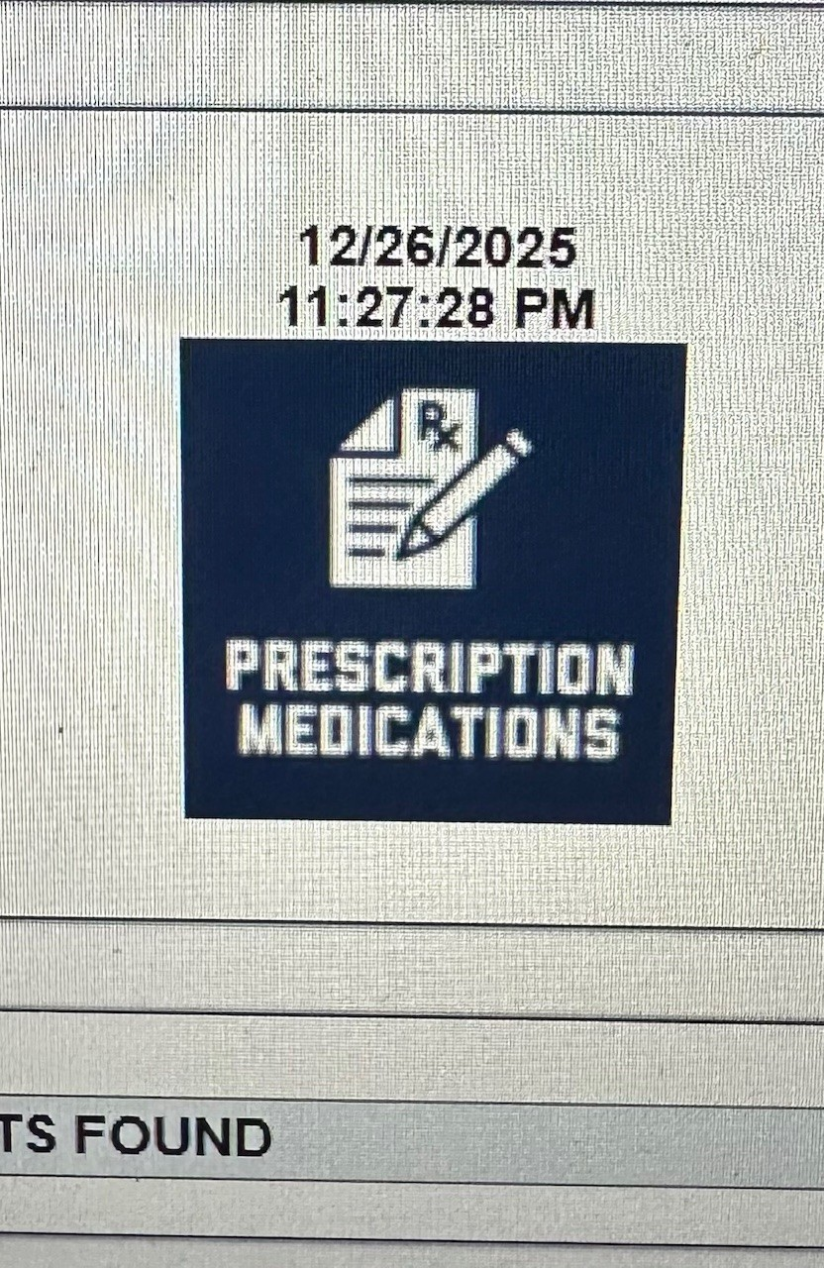
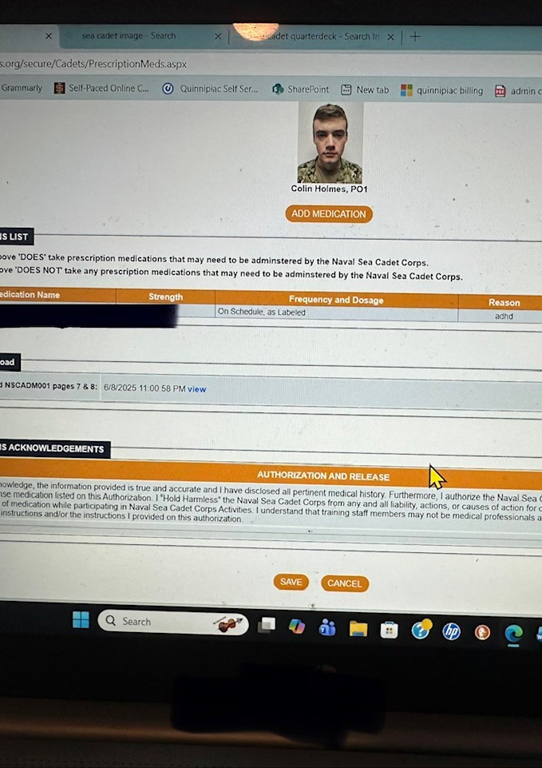
Complete the prescription medication section in full and save.

Slide 18
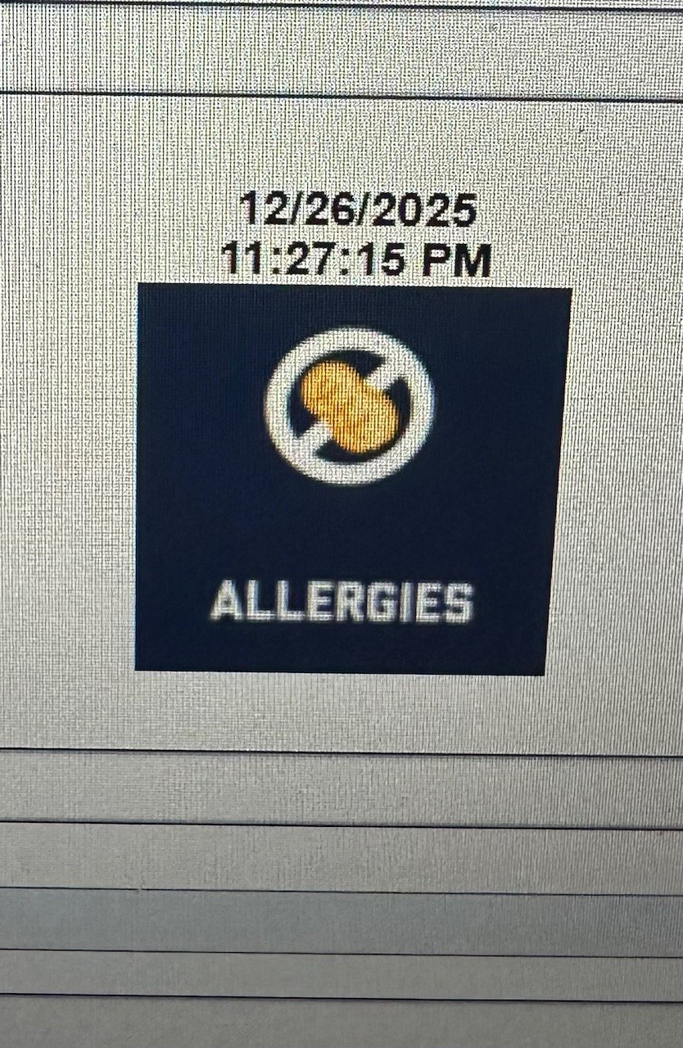
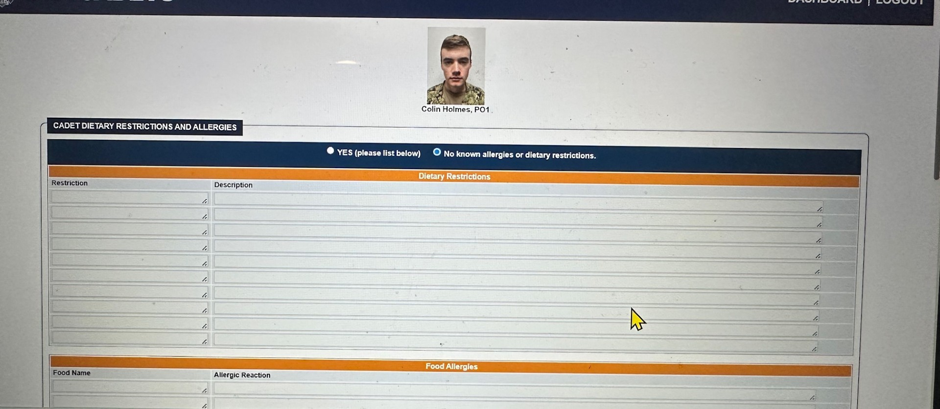

Complete and save the allergy section. If your cadet requires an Epi-Pen or any other medication, a 7/8 needs to be completed and uploaded under the medication section . Your child needs to bring their Epi-Pen with them to each drill. Notify the administration team if your child has allergies. 911 WILL be called in the event of an emergency or if Epinepheline is needed then the parent will be called.

Slide 19
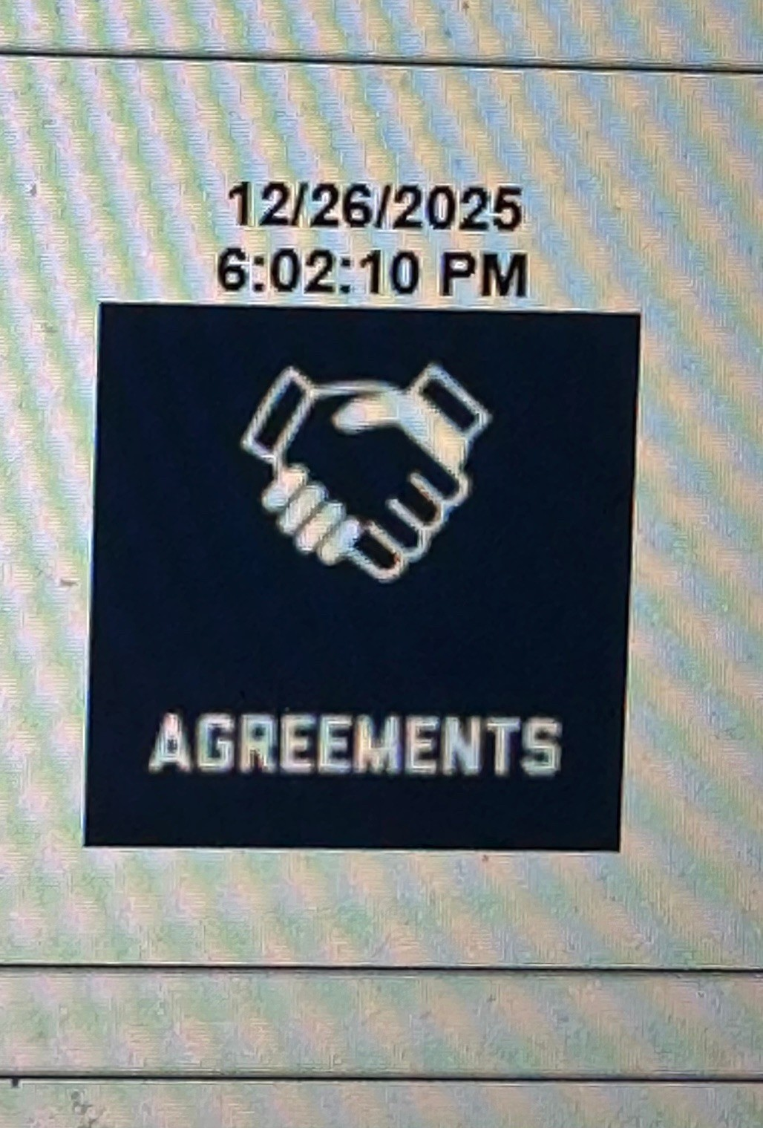
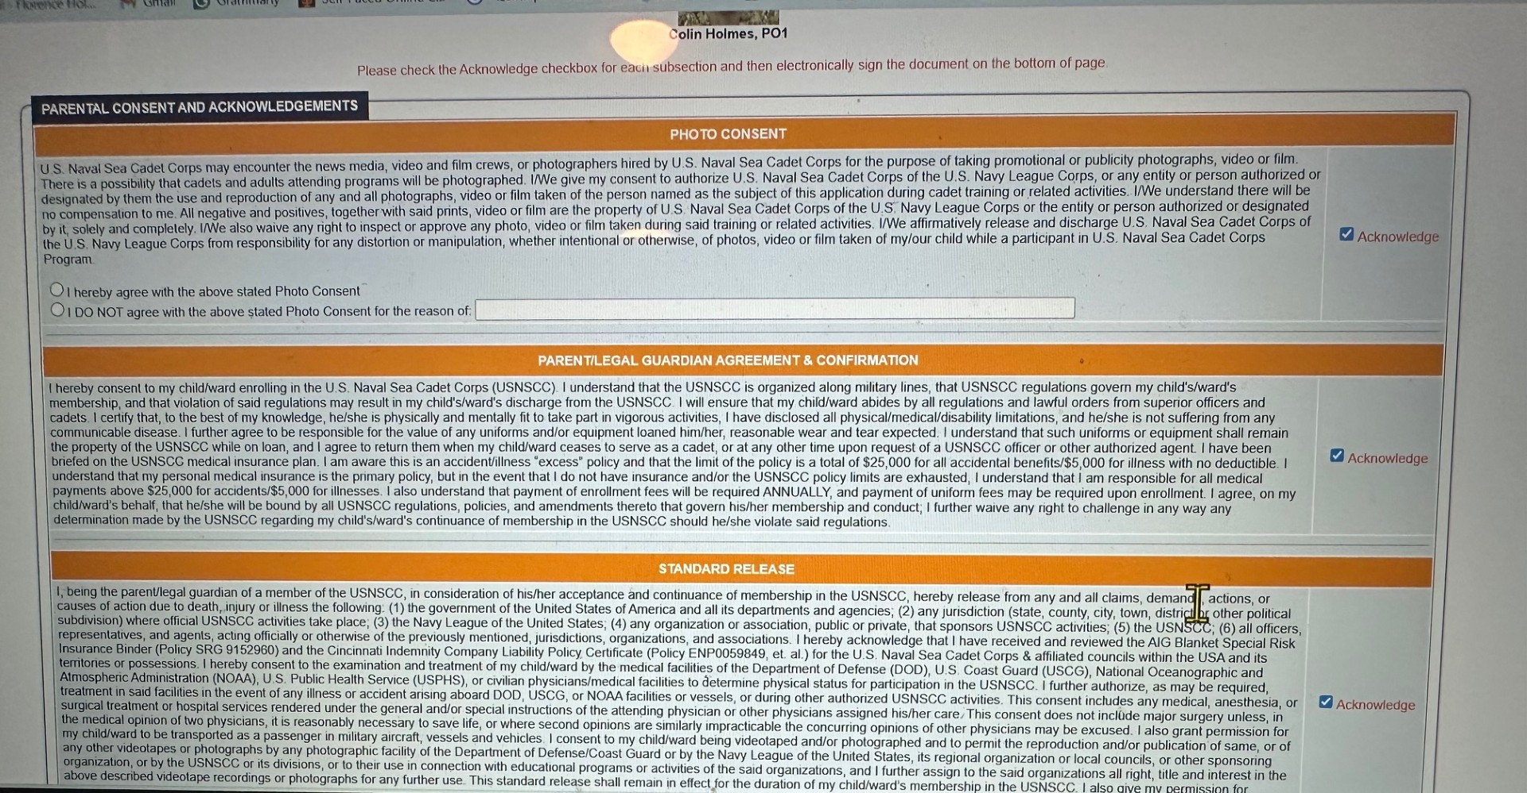
Complete all agreements and save

Slide 20
Forms
Forms 5/6 Microsoft Word - NSCADM001 are mandatory
Forms 7/8 Microsoft Word - NSCADM001 are mandatory for any prescribed medications including asthma, seizure, Epi-Pens, ADHD, or similar
Forms 9/10 Microsoft Word - NSCADM001 ***** Not all accommodations are accepted or could prevent training. Each accommodation is viewed by accepting training, not Mass Bay

Slide 21
Questions
Contact
If you have questions regarding uploading information, please contact me at 617-460-7777 or fholmes@bostonseacadets.org
Complete
Please complete each section
Save
Save each section

