Slide 1
Sea Cadets Trainings
Florence Holmes

Slide 2


Slide 3
What you need to do to become eligible
Have time in grade 3 months
The 5/6, 7/8 completed and are only good for 1 year.
All other digital documents must be updated within 3 months of trainings.
***** you may not be approved if this is missing..*****
Pass your PRT based on your age requirements
Progressing in your coursework
Notify Your X O and LPO once you have signed up for training
Age: NLCC VS. NSCC

Slide 4
Your cadet is required to complete the basic recruit training in the first year and 1 training annually.
In order to rank up the cadet will need to staff a training and complete coursework.
NLCC has their own trainings
NSCC must do recruit training before POLA

Slide 5
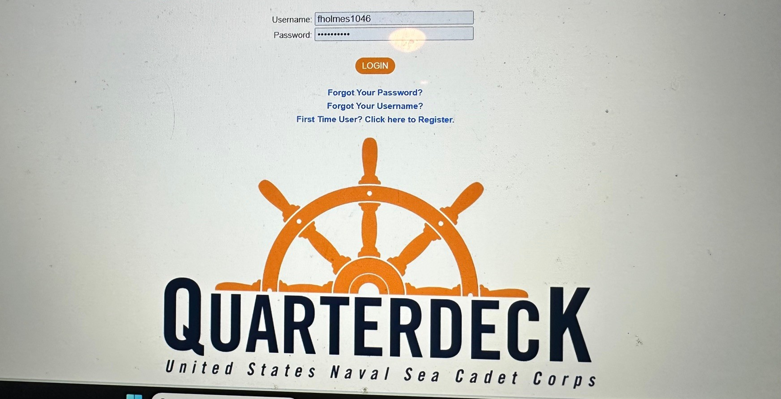

Slide 6
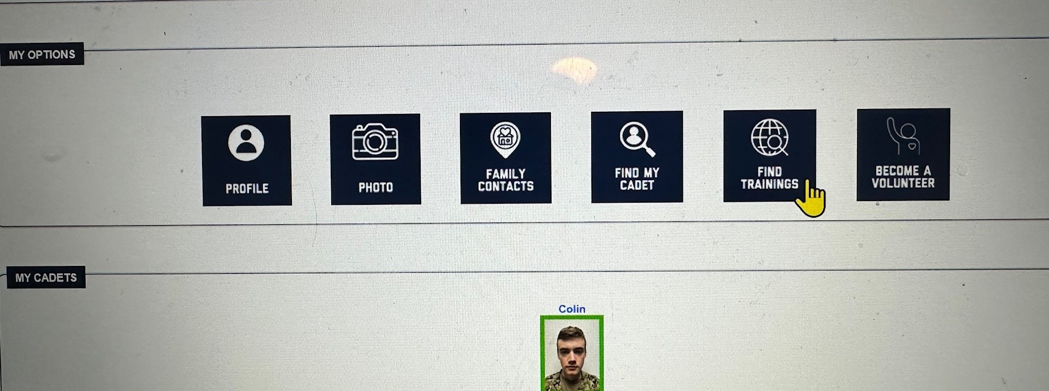
There are approximately 300 trainings during the summer, 70 during the winter, and additional during other vacations

Slide 7
Find a training by:
Month
Interest / Category
State
Date

Slide 8
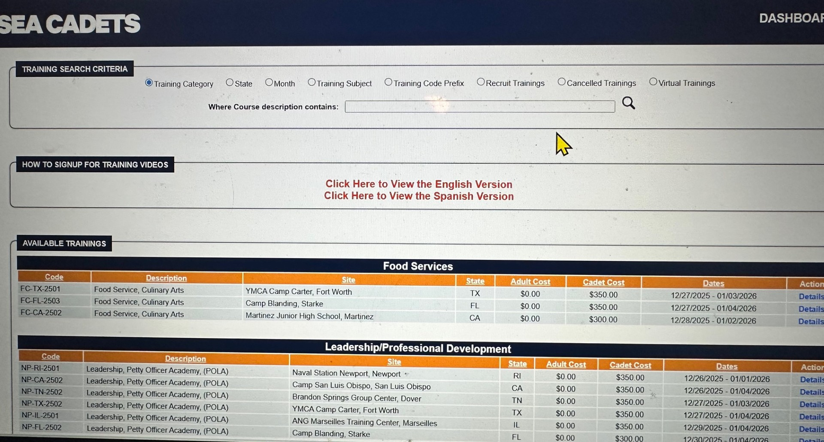
Interest / Category

Slide 9
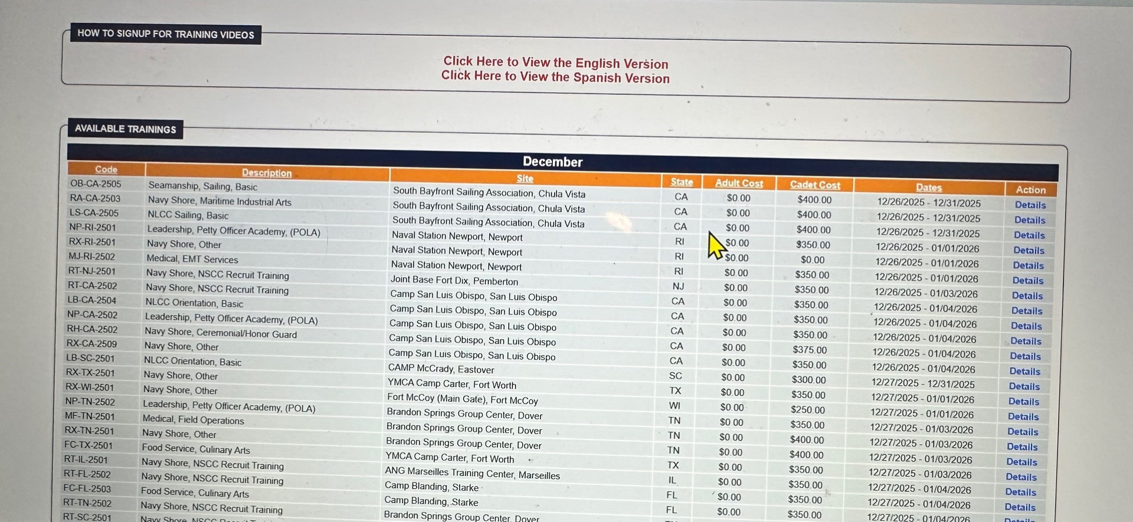
Month

Slide 10
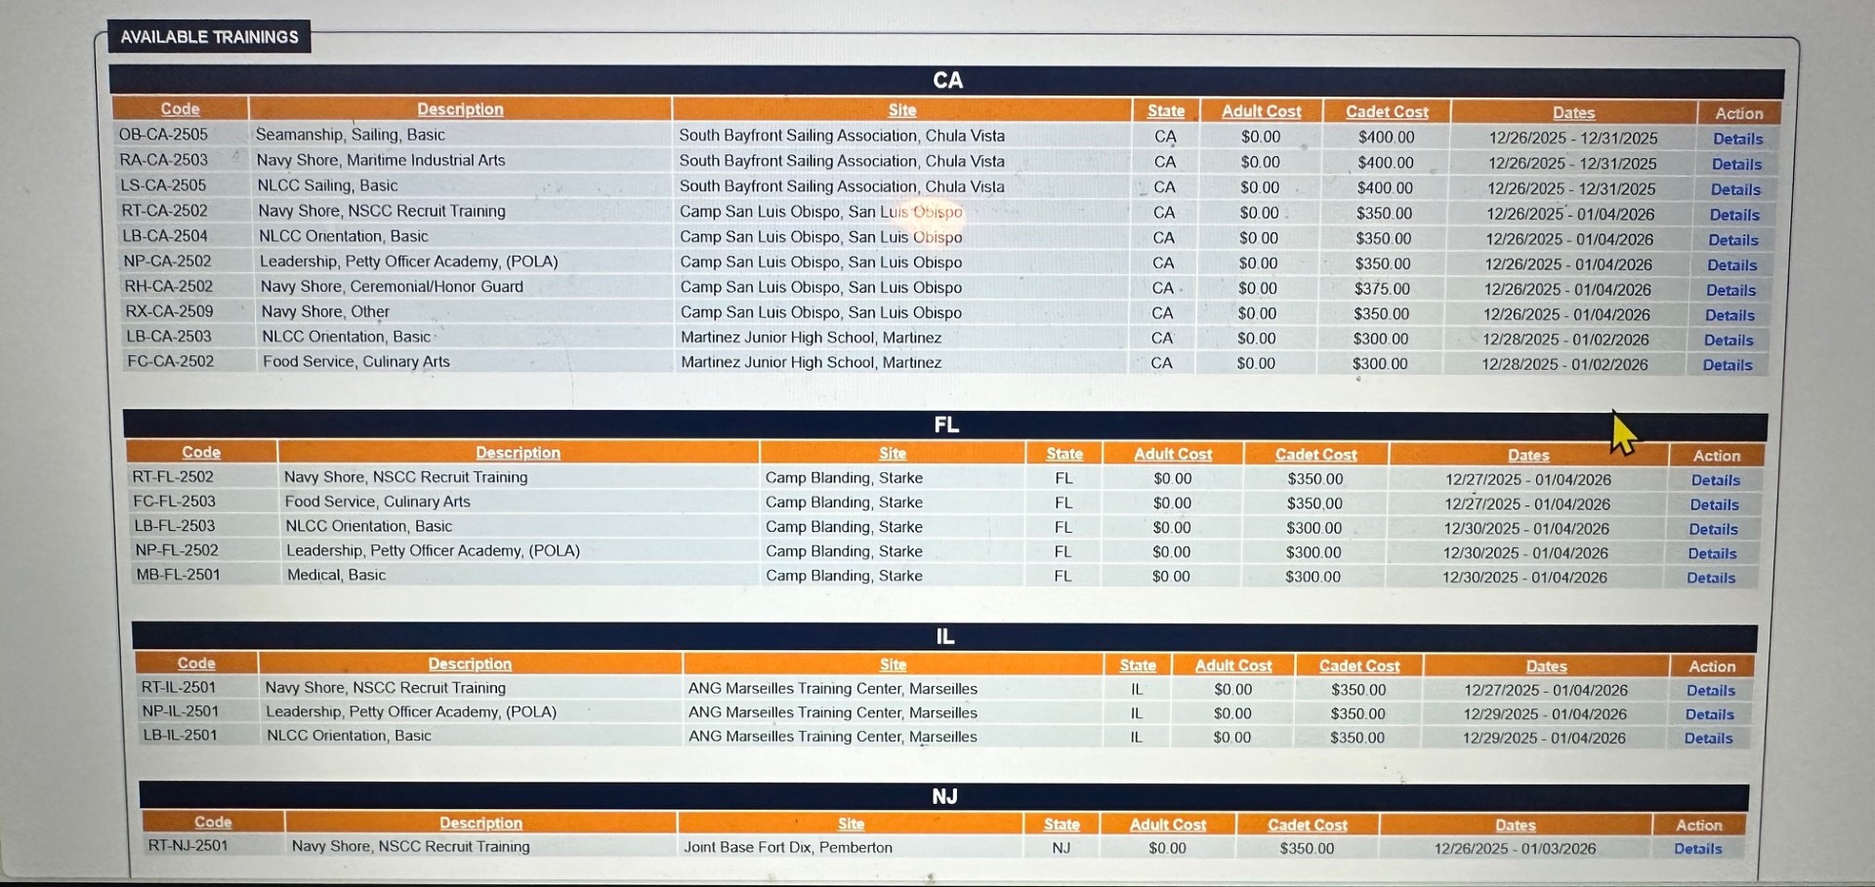
State

Slide 11
Click on the DETAILS for training information & eligibility

Slide 12
Training Information in the details
Capacity of cadets, staff, and escort officers male / female
Military physical academic demanding & stem related
Training attachments to view and complete ********
Advancement credits / Ribbon received
Event descriptions
Lodging info
Travel info
Training requirements
Payment
Eligibility
Apply

Slide 13
Click " Apply " at the bottom of the details. If you meet the eligibility requirements,
you will see the word "apply." ONLY apply if you are attending.
Ensure your PRT is active and all medical documents are up to date. If not, you may miss the opportunity.
Remember Cadets across the country are applying for the same trainings and space is limited (some more than others SCUBA, firefighting, and aviation)
X O may want to be notified if you have applied. If planning on attending a training, ask the X O at drill how they want to be notified.
Once applied you will receive information regarding acceptance (not immediately).
The accepting location is the one that completes this. Mass Bay has no control over this. However, if concerns or a period of time passes, reach out to administration.
If accepted pay your fee (start at $350.00) this includes food & lodging. Scuba is one that costs more.
Travel expense is additional
Gather your Seabag list and obtain necessary items

Slide 14
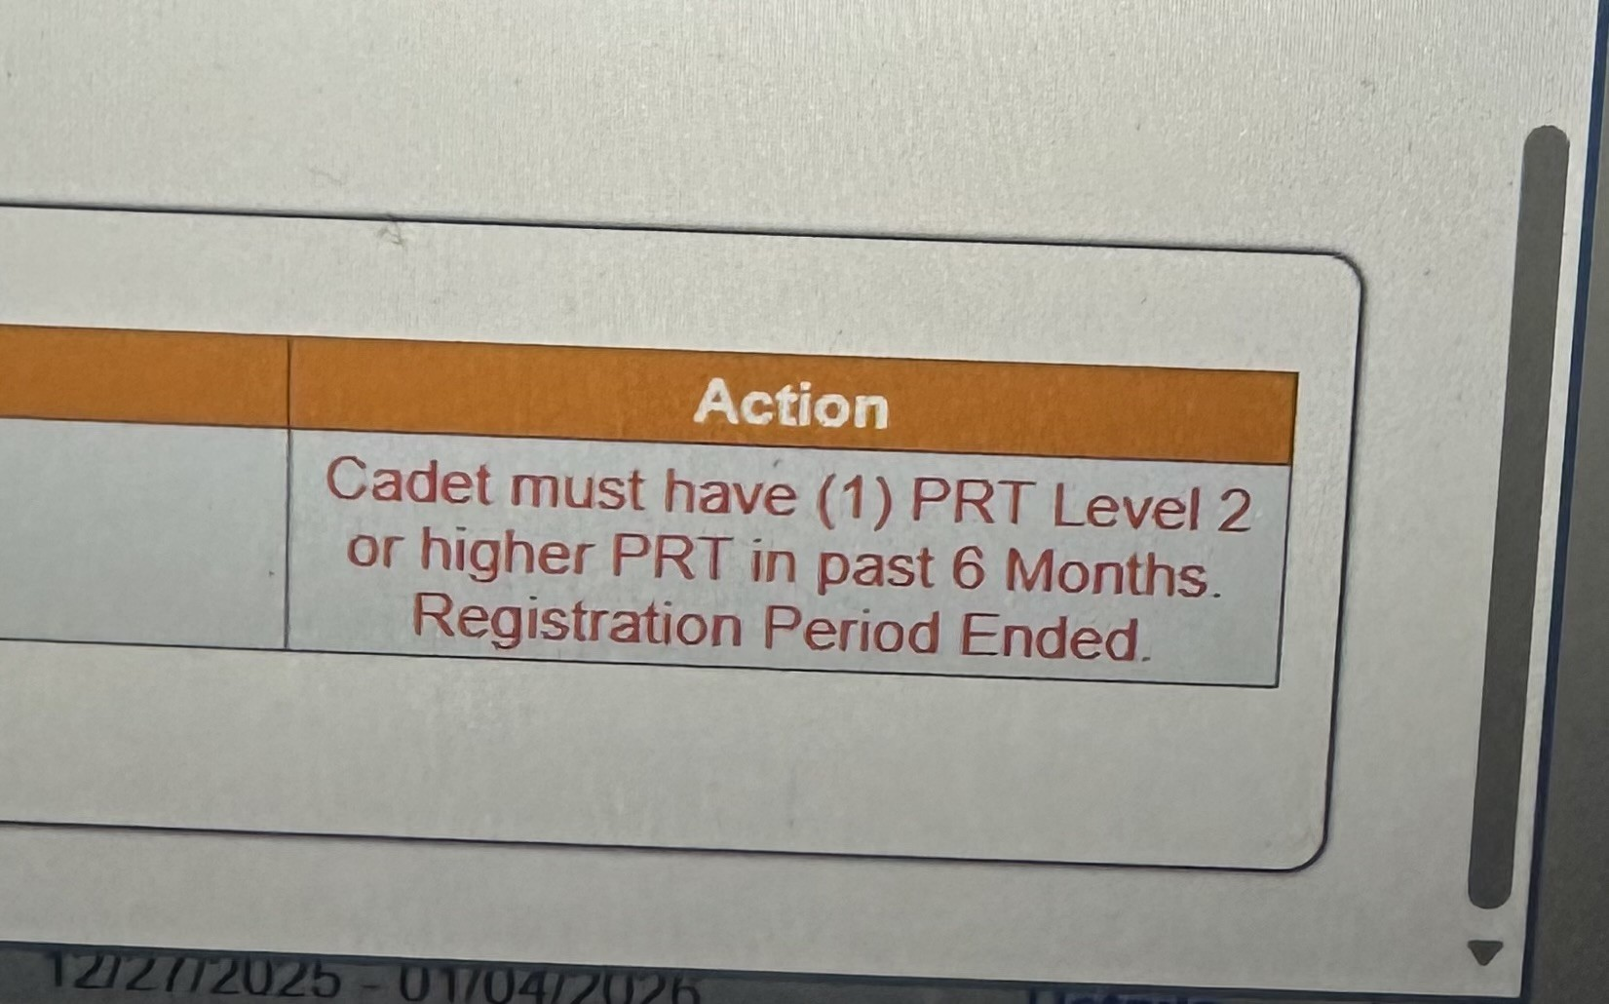
Notify the XO or CO if you see a comment that prevents you from applying if you think there is an error.

Slide 15

If questions arise, cadets should send an email to their LPO or to administration.

